Slide 1
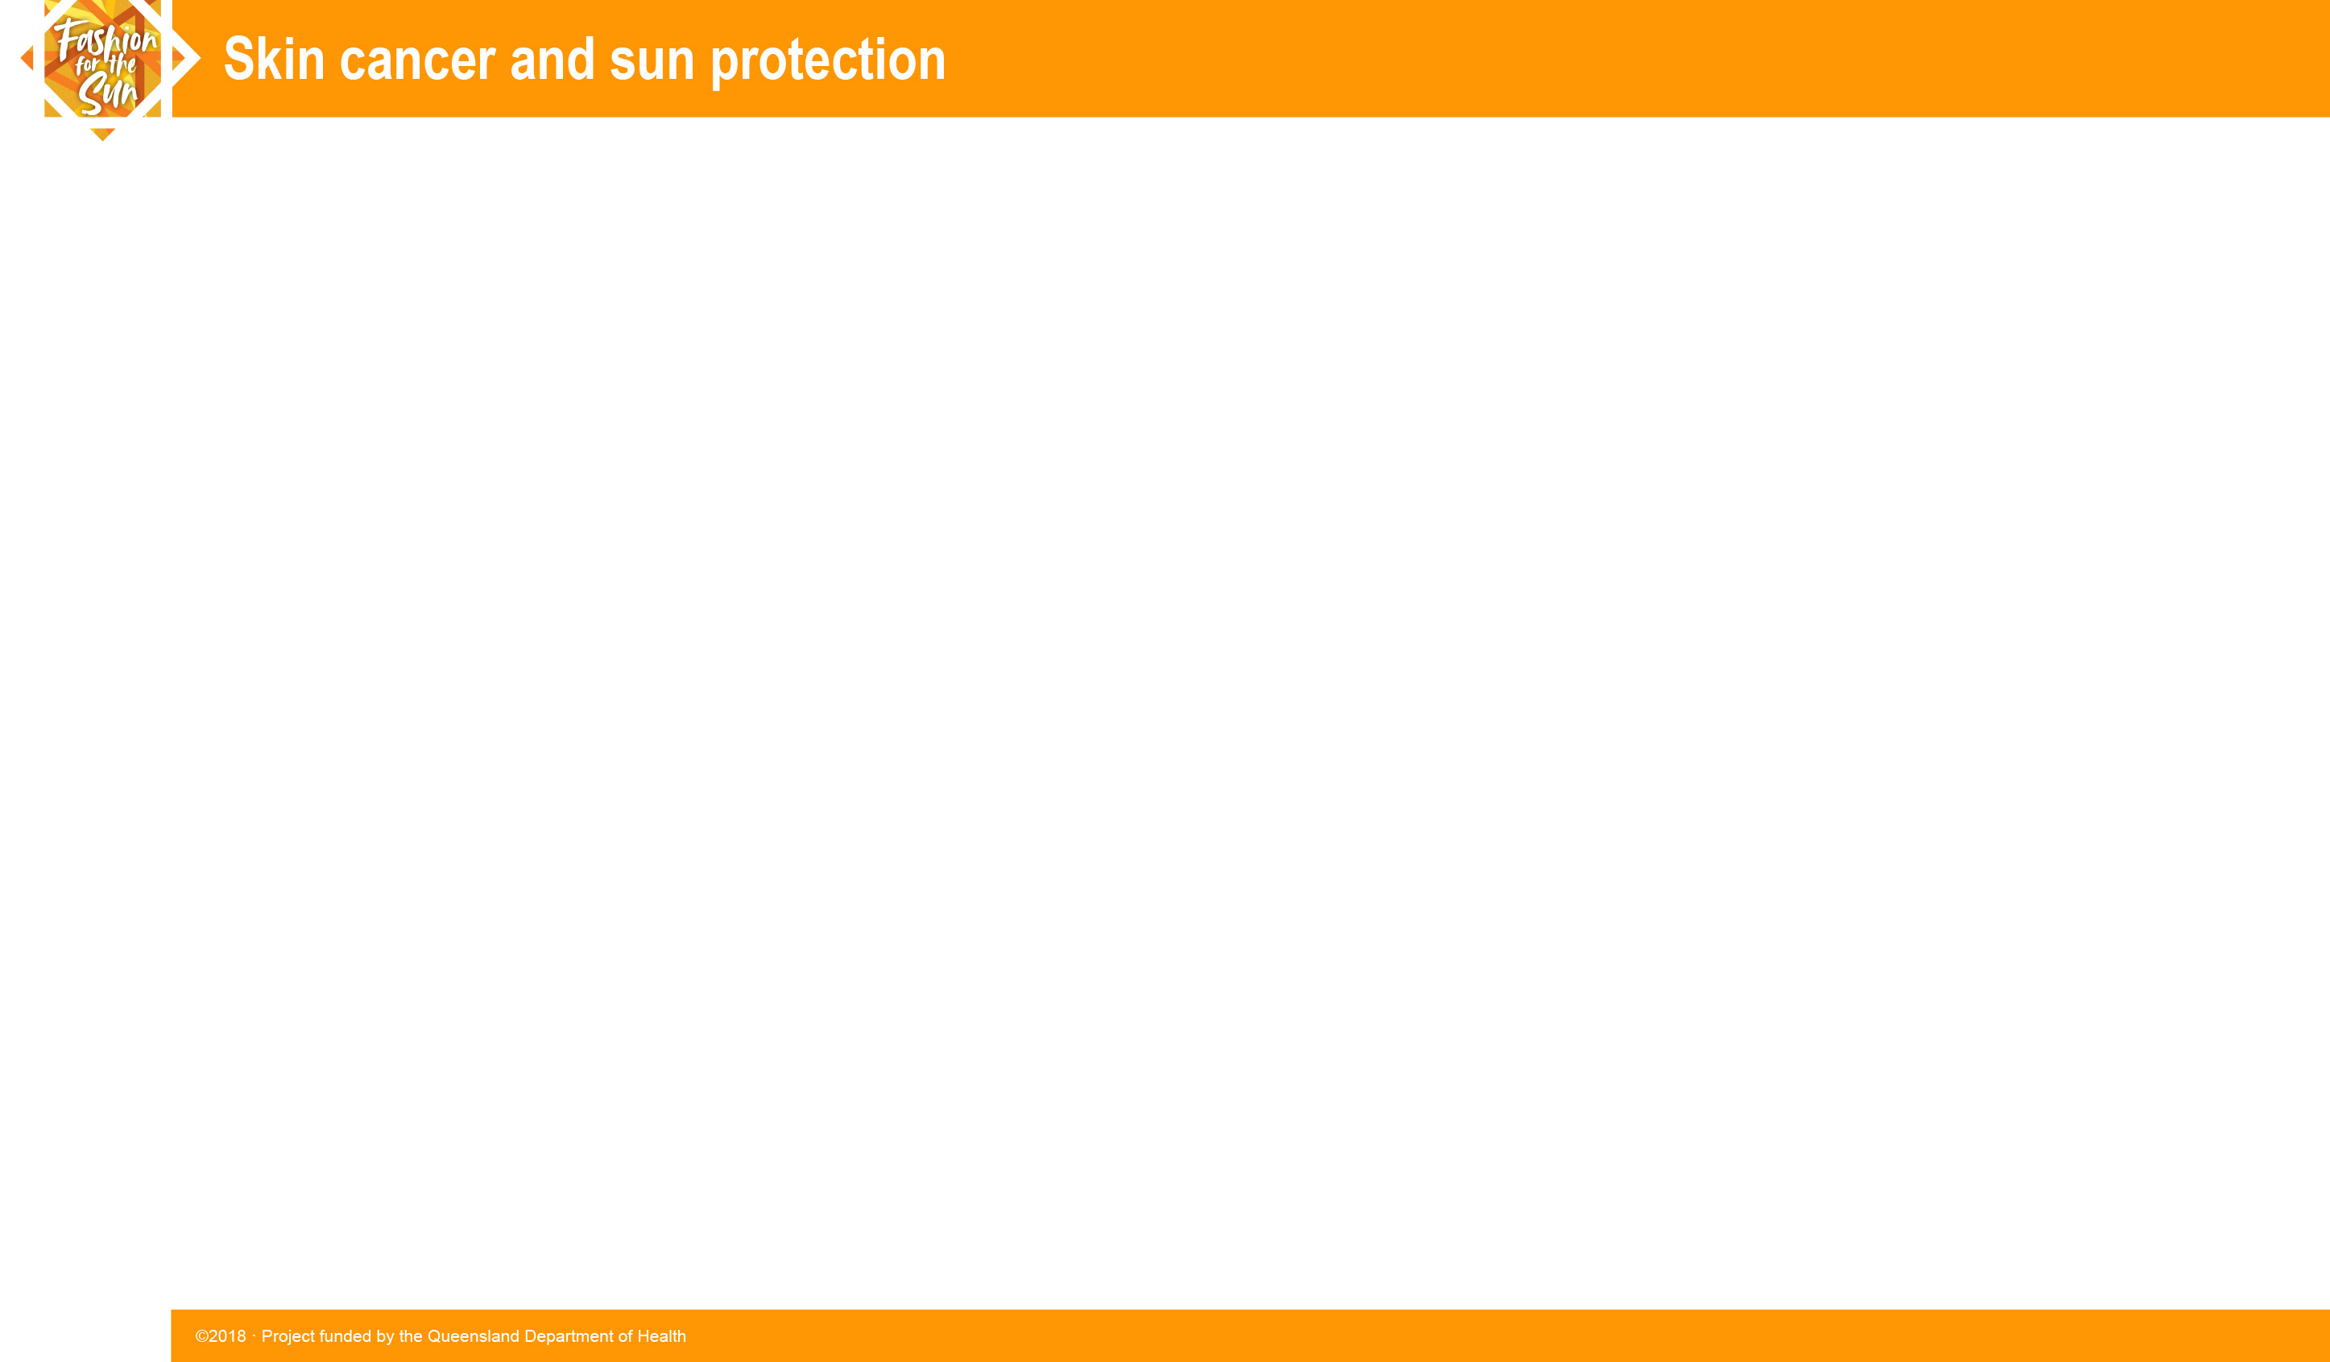
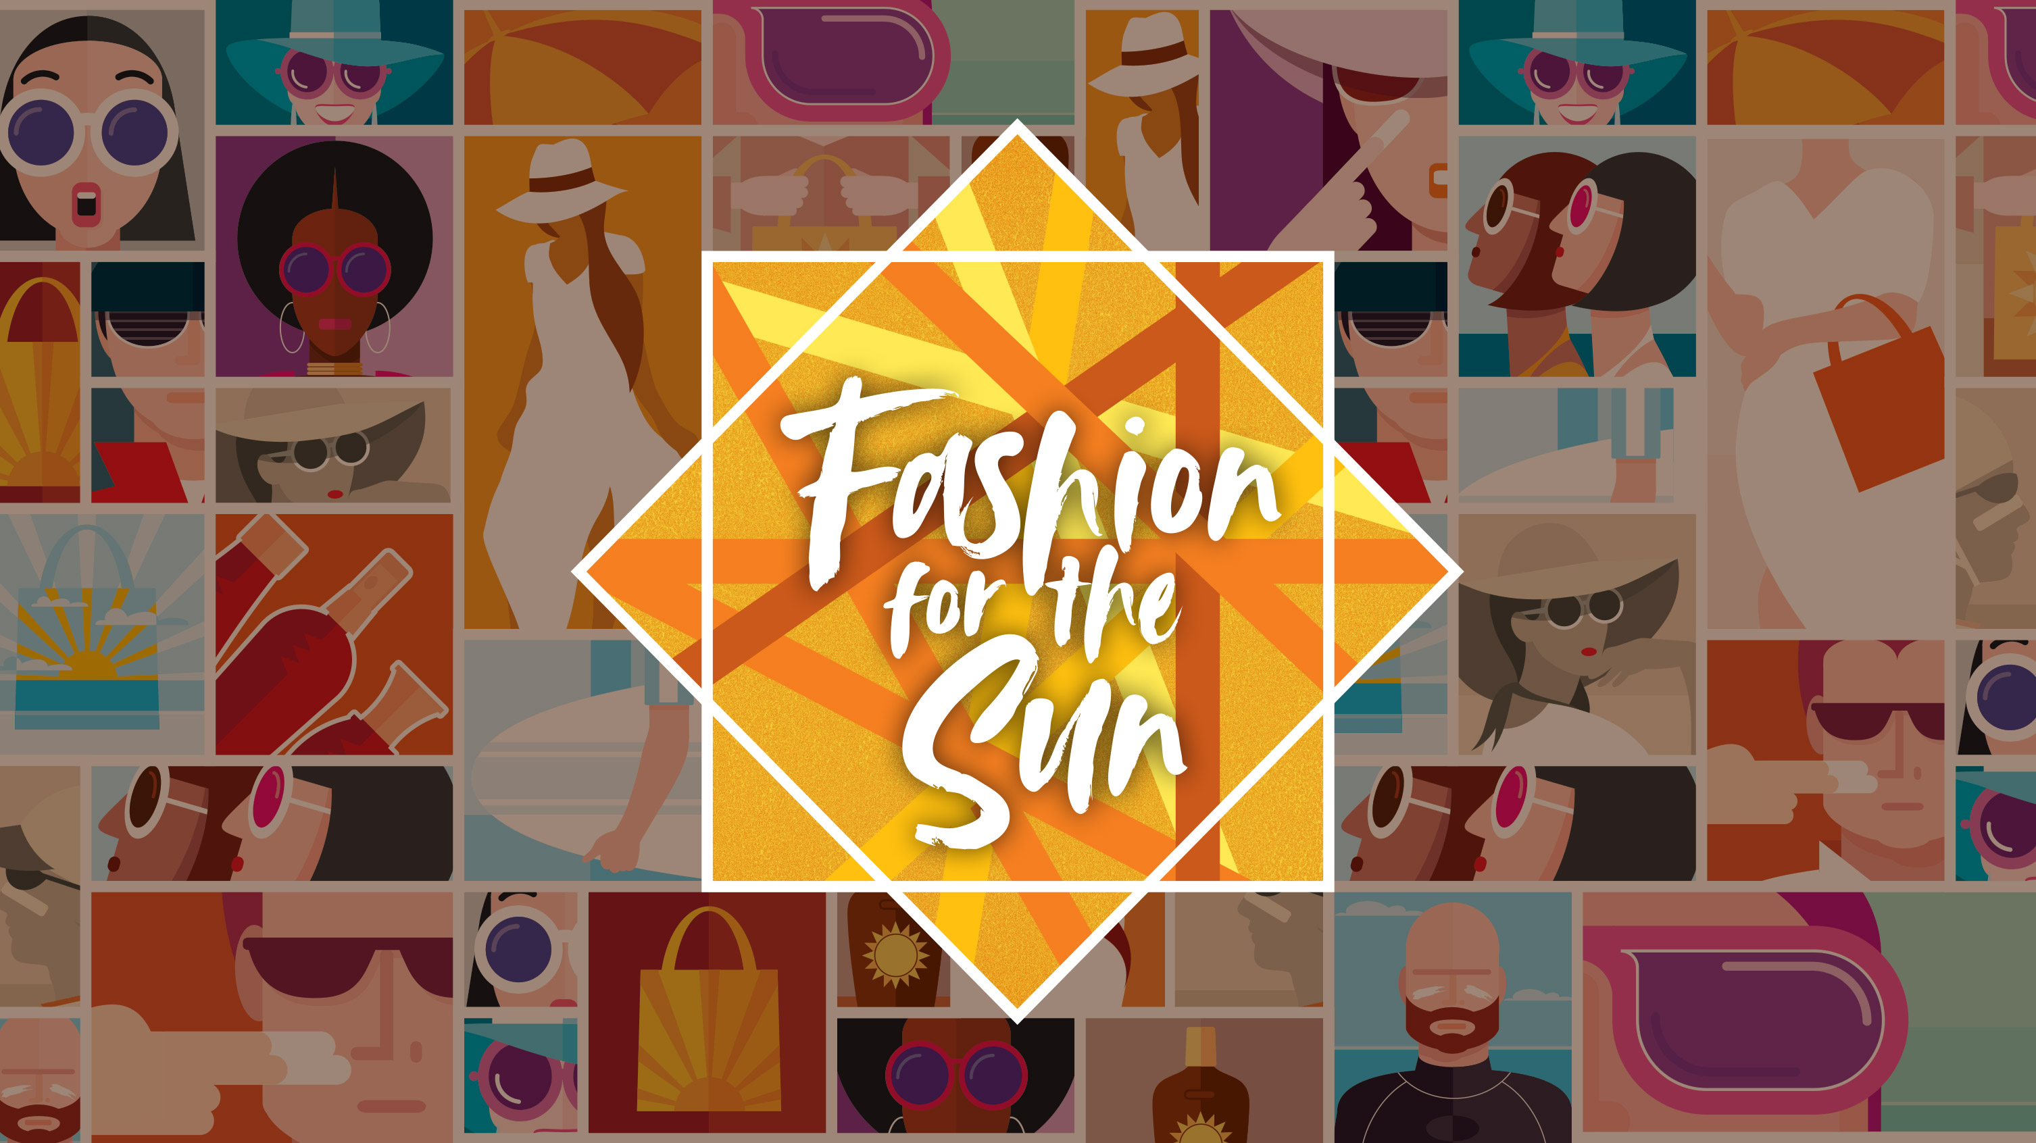

Slide 2
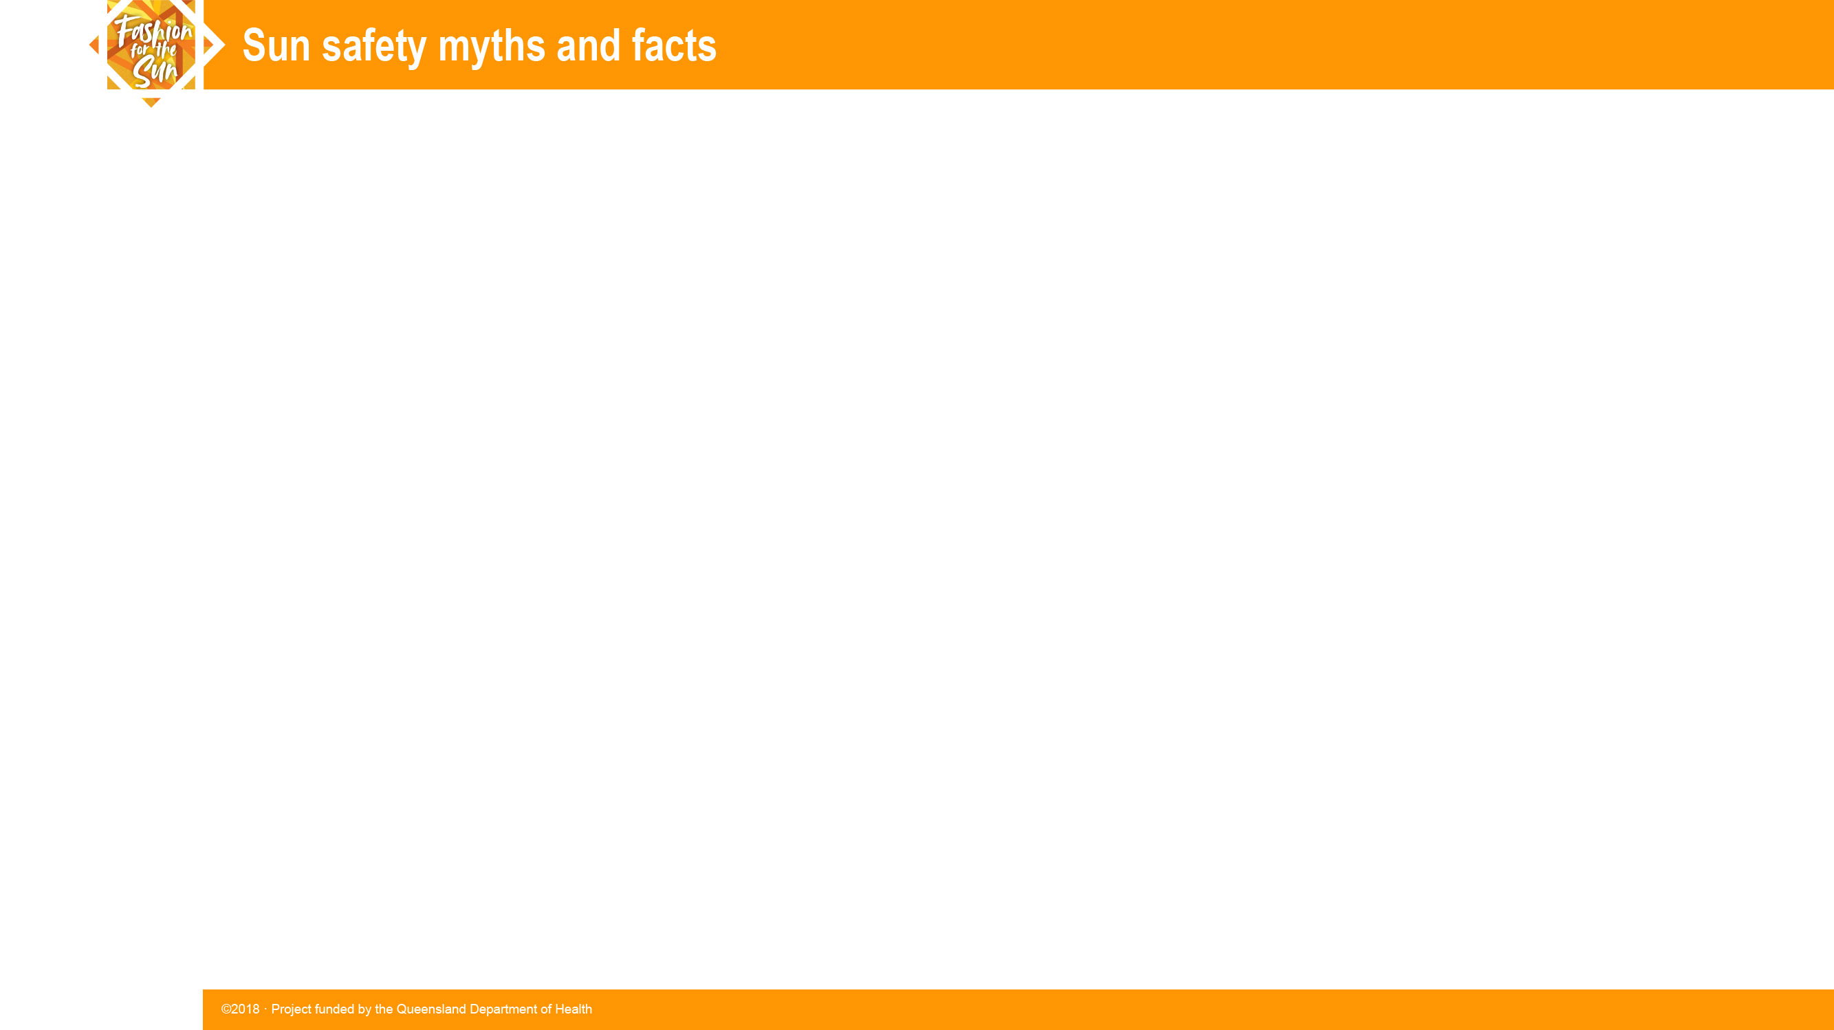
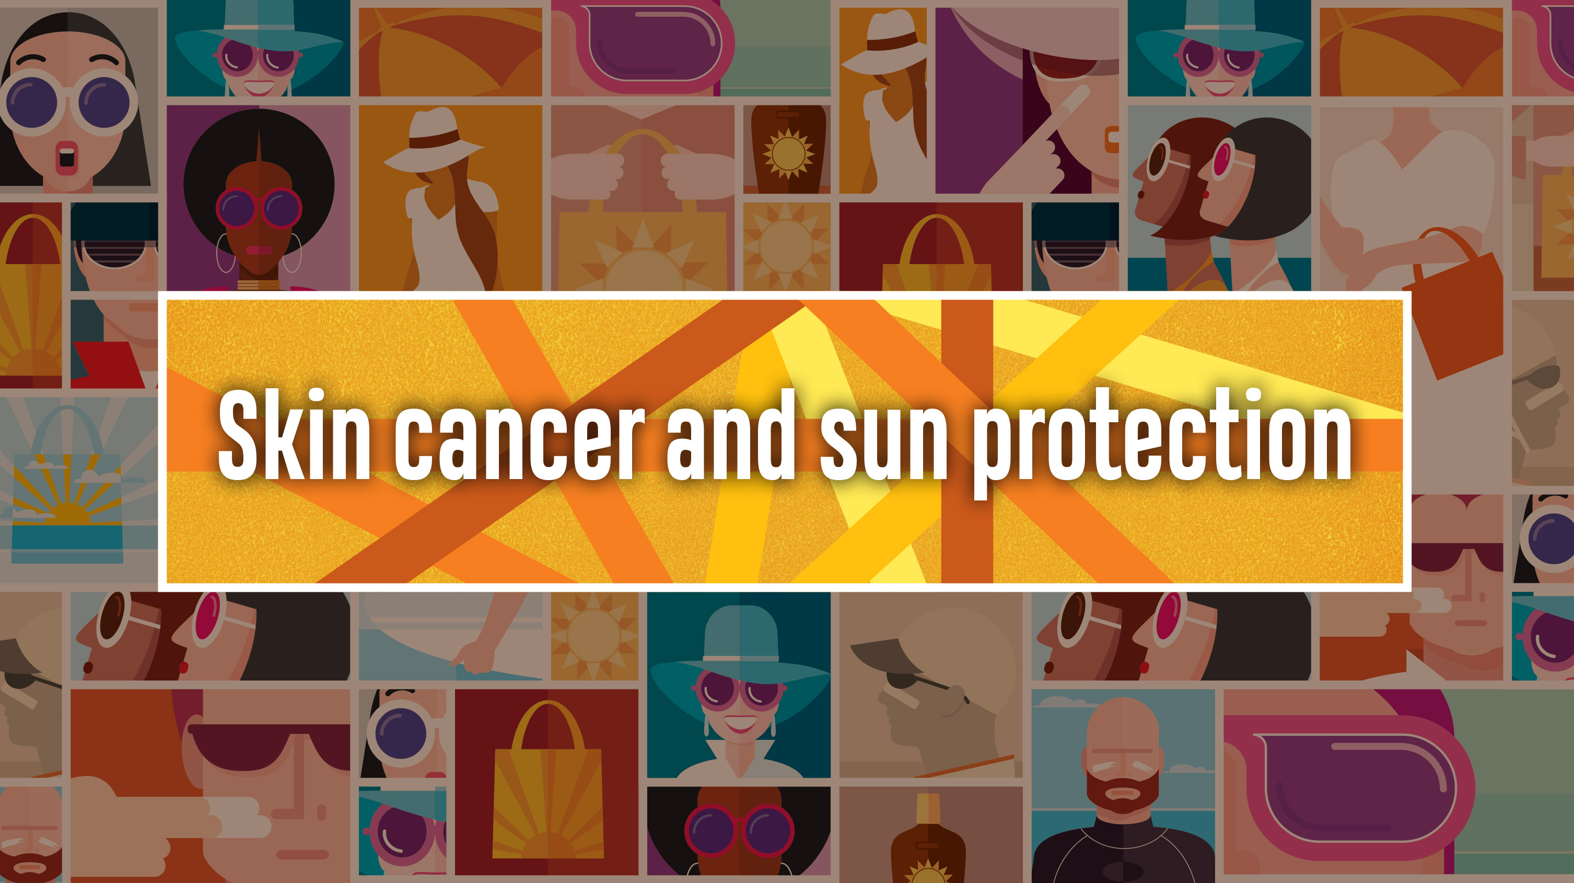
Notes:
Notes for the teacher:
This presentation introduces skin cancer and sun protection, covering for example:
what skin cancer is, different types and statistics
risk factors and prevention
how to check for signs of skin cancer.
The PowerPoint presentation: Sun safety myths and facts is a suitable complement to this presentation.
The following fact files could be useful handouts for students to support this presentation:
Fact file A: At a glance: Skin cancer
Fact file B: At a glance: Skin cancer statistics
Fact file D: Five ways to be sun safe.
Other resources to support this topic include:
Student response sheet 1. What is your understanding of skin cancer? (A 3-level comprehension guide)
Student response sheet 2. Interpreting the skin cancer statistics
Student response sheets 3A and 3B: making sense of skin cancer statistics A and B.
The notes that accompany these slides are there to assist the teacher. It is expected that the teacher will decide which of this additional information is suitable for the student cohort. The notes also provide additional information that might be useful for responding to student questions.

Slide 3

About skin cancer
• A disease of the body’s skin cells
• Develops when skin cells are damaged by ultraviolet radiation (UVR) from the sun.
• The damaged cells can become malignant (cancerous) and travel to other areas of the body.
Notes:
What skin cancer is
Skin cancer is a disease of the body’s skin cells. It is usually caused by the sun’s ultraviolet radiation damaging the skin cells. When the skin cells die or are damaged, more skin cells are produced to replace them. Sometimes, this regrowth becomes disordered and cells multiply and form a tumour (or growth). The tumour can continue to grow and destroy healthy cells.
The impact of the sun’s rays
Each time the skin is exposed to ultraviolet radiation (UVR) from the sun, changes take place in the structure and function of the skin cells. Over time, the skin cells can become permanently damaged. This damage gets worse with each exposure to ultraviolet radiation and increases the risk of skin cancer when new skin cells are produced to replace the damaged ones.
How it spreads
Cancer cells can break off from the tumour and can be carried to other parts of the body by the bloodstream or lymphatic system. These cancer cells can then multiply and form other tumours in other parts of the body, including the brain, liver and lungs.

Slide 4
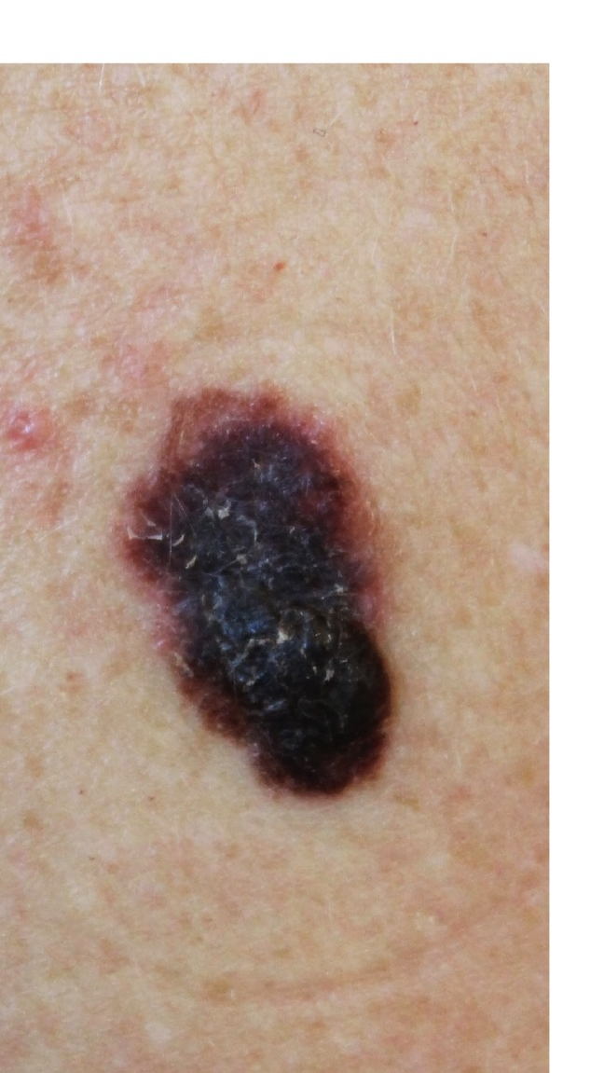
Types of skin cancer
Melanoma
• Less common, but most dangerous
• Causes most deaths due to skin cancer
• Almost always curable when detected early
Notes:
Melanomas can occur anywhere on the skin, but are more likely to develop in certain locations. The back and shoulders are the most common sites in men. In women, the legs are most commonly affected. However, they can occur anywhere but are rarely found on areas of the skin that are always shielded from the sun.
Melanoma is much less common than basal cell and squamous cell skin cancers, but it can be far more serious. Like basal cell and squamous cell cancers, melanoma is almost always curable in its early stages. However, melanoma cells can travel in the bloodstream and grow (metastasize) in other parts of the body particularly the brain, bones, liver and lung. If the melanoma travels and metastasizes they can grow very rapidly and are very difficult to treat, and the prognosis is generally poor.

Slide 5
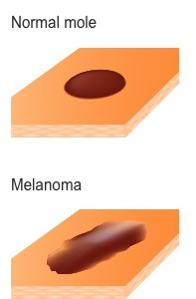
Types of skin cancer
Melanoma
Signs:
• New— A new spot
• Changing— A spot that changes in colour, size or shape
• Growing— A mole that grows quickly
• Different— A mole or spot that looks different to others you have
If you have any concerns about your skin, you should see a doctor as soon as possible.

Slide 6
Types of skin cancer
Non-melanoma Basal Cell and Squamous Cell Carcinomas
• Most common
• Can nearly always be cured
• Can scar the skin if not treated
• Usually slow growing
• Found on parts of body exposed to the sun
— hands, head and neck
Notes:
Skin cancers are often divided into 2 groups – melanomas and non-melanomas. It is important for you to know what melanomas and non-melanomas look like. That way, you can find them at the earliest possible stage, when skin cancers are most easily cured. Look out for the following warning signs in non-melanoma carcinomas:
BCC: a small lump or scaly patch that might have a pearly appearance or become ulcerated
SCC: flat, scaly patches or sores that won’t heal and might bleed easily.
Non-melanomas include basal cell cancers and squamous cell cancers and are the most common cancers of the skin. They are called non-melanomas because they develop from skin cells other than melanocytes (the cells that make the brown pigment that gives skin its color). Both basal cell and squamous cell cancers are found mainly on sun-exposed parts of the body such as the hands, head and neck, and their occurrence is related to lifetime sun exposure.
Non-melanomas rarely spread elsewhere in the body and are more commonly diagnosed among older people.

Slide 7
Statistics for melanoma in Australia
Incidence (new cases per 100,000 people):
• Australia— one of the highest rates in the world
• Queensland— highest rate in the world. However, as at 2016 rates were :
- plateauing in those aged 40–59 years
- declining in those under 40 years of age.
- 2018— estimated14,320 new cases of (8653 males and 5667 females)
Sex
• More common in men than women (60:40)
Notes:
The Australian incidence rate of melanoma (number of new cases per 100,000 people) is one of the highest in the world. There were:
14 320 estimated new cases in 2018 (8653 males and 5667 females)
13 283 estimated new cases in 2016 Australia (7847 males and 5436 females)
12 510 new cases in 2012.
Queensland has the highest incidence rate for melanoma in the world. Each year around 3700 new cases are diagnosed. However, as at 2016, after 30 years of prevention campaign the rates were:
plateauing in those aged 40–59 years
declining in those under 40 years of age.

Slide 8
Statistics for melanoma in Australia (cont.)
Mortality rate (number of deaths per 100,000 people)
Estimated that in 2018 in Australia 1905 deaths due to melanoma.
From1982 to 2016, the mortality rate:
• dropped for the three youngest age groups (0–59yrs)
• increased for the three oldest age groups (60yrs +).
Improvements attributed to active campaigning for sun protection.
Despite this, the actual number of deaths increased for all age groups except those aged under 40 years due to increased population and increased incidence in some groups.
Notes:
From 1982 to 2016, the mortality rate (number of deaths per 100,000 people):
dropped for the three youngest age groups (0–39 yrs, 40–49 yrs, 50–59 yrs)
increased for the three oldest age groups (60–69 yrs, 70–79 yrs and 80 yrs and over).
The number of deaths in the same period increased for all age groups except those aged under 40 years:
For people 0–39 years of age, deaths dropped from 93 in 1982 to an estimated 50 deaths in 2016—for this age group, the number of deaths has been progressively decreasing since 1995. This is attributed to the many sun protection campaigns and sun protection policies e.g. in schools that have been in place for most of their lives. However, melanoma is the most common cancer in 15–39 year-olds, making up 20% of all their cancer cases.
For those aged 40–59 years, the declining mortality rate (number of deaths per 100,000 people) was offset by the population increasing by approximately 50% in this period so the actual number of deaths increased.
For those aged 60 years and over, both the increased mortality rate as well as the growth in population in this age group contributed to an increase in the number of deaths.
The number of deaths per year from melanoma among people over 40 years of age continues to increase and is expected to for many years due to unprotected UVR exposure in younger years.
The number of deaths in Queensland in 2016 due to melanoma was 310.

Slide 9
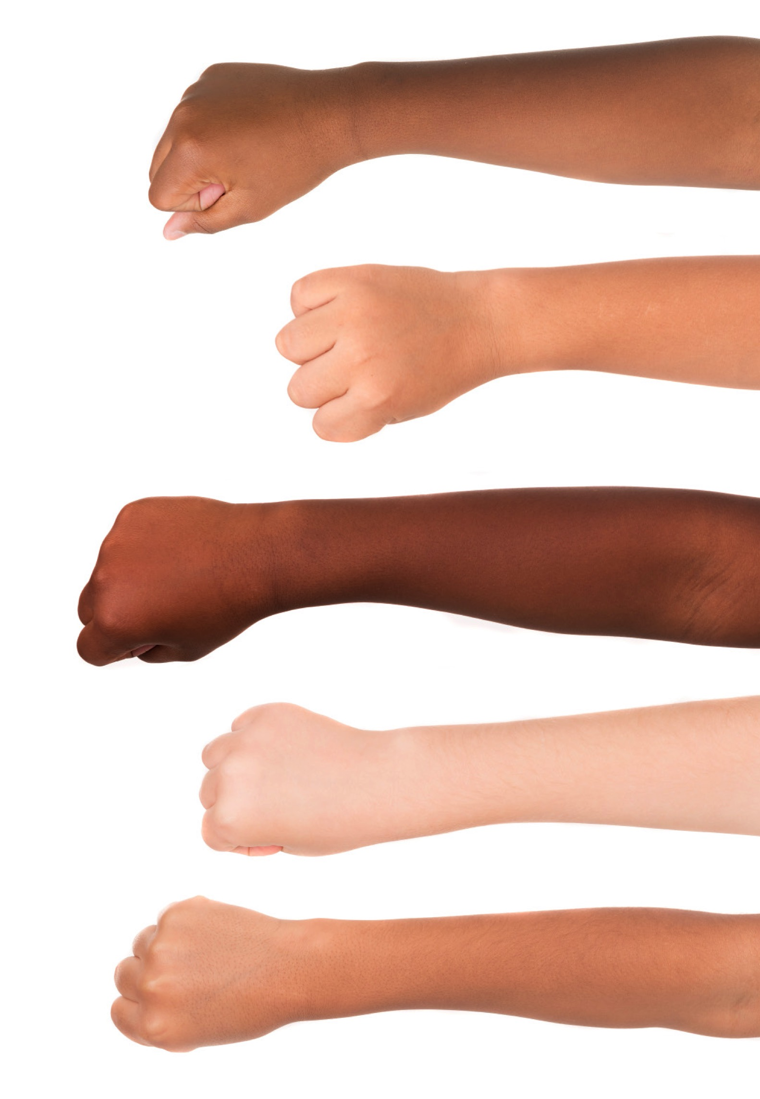
Who is prone to sun damage?
Everyone!
• People with light skin much more likely to sustain UVR damage from the sun
• However, darker-skinned people also can be affected.
Notes:
Everyone's skin and eyes can be damaged by the sun and other UV rays. Those with lighter skin are more likely to burn. Sunburns are thought to increase your risk of skin cancer, especially melanoma. But UV exposure can raise skin cancer risk even without causing a sunburn.
Although people with light skin are more likely to have sun damage, darker skinned people also can be affected. People with darker skin tan more easily than others. But tanning is still a form of skin damage. Tanning occurs when UV radiation is absorbed by the skin, causing an increase in the activity and number of melanocytes, the cells that make the pigment melanin. Melanin helps to block out damaging rays up to a point, which is why darker skinned people burn less easily. While some people such as naturally dark (or olive) skinned people have skin types that are less likely to burn, they are still at risk of developing skin cancer. However, the risk is lower.
Nevertheless, dark-skinned people still get skin cancer, although their skin cancers may develop in unusual places, for example under their fingernails or on the soles of their feet.

Slide 10
UVR exposure risks
• Babies and young children
• Excessive exposure in the first 20 years of life
• Repeated exposure
Skin cells are often damaged in childhood but sun exposure in adulthood can trigger these damaged cells to turn cancerous.
Notes:
The skin of babies and young children is particularly vulnerable
Excessive exposure in the first 20 years of life more than doubles the risk of developing melanoma.
Repeated exposure adds up over time, resulting in skin damage.
Research suggests that while skin cells are often damaged in childhood, sun exposure in adulthood can trigger these damaged cells to turn cancerous.

Slide 11
Risk factors—Personal
People who:
• are lighter skinned
• have freckles
• have blonde, red, or light brown hair
• have a large number of moles on their skin
• have a skin type that burns easily
• have a personal history of skin cancer.

Slide 12
Risk factors—Lifestyle
Sun exposure
• Prolonged exposure to sunlight 10am to 3pm
• Lots of time outdoors without adequate sun protection
• Predominantly work outdoors
• High exposure to sun in first 20 years
Place of residence
• High altitudes (due to increased UV)
• Where the UV Index is high all year round e.g. Queensland and Northern Territory and parts of other states that are north of 30˚C
Solariums
• Active tanning by use of solariums and tanning lamps
Notes:
Sun exposure
In some parts of Australia you need to use sun protection strategies every day. There is a SunSmart app that links to your location and tells you each day the times when sun protection is needed.
Place of residence
Distance from the equator influences when sun protection is necessary. Sun protection may be needed:
All year for latitude 30ºN to 30ºS—all of Queensland and the Northern Territory, Western Australia north of Kalgoorlie, New South Wales north of Coffs Harbour, South Australia north of Lake Torrens
August to May for latitude 30ºS to 40ºS—Western Australia south of Kalgoorlie, New South Wales south of Coffs Harbour, South Australia south of Lake Torrens, all of Australian Capital Territory and Victoria
September to April for latitude 40ºS to 50ºS—all of Tasmania
There is increased UVR at high altitude e.g. ski slopes.
Solariums (rooms with sunlamps or sun beds, used to acquire an artificial suntan)
As noted in the Cancer Council’s website (2018), solariums emit UVA and UVB radiation, both known causes of cancer (a solarium). The Cancer Council does not recommend solarium use for cosmetic tanning under any circumstances. As of January 2016, commercial solariums were banned in all states in Australia. ACT has also banned commercial solariums. There are no commercial solariums operating in the Northern Territory.

Slide 13
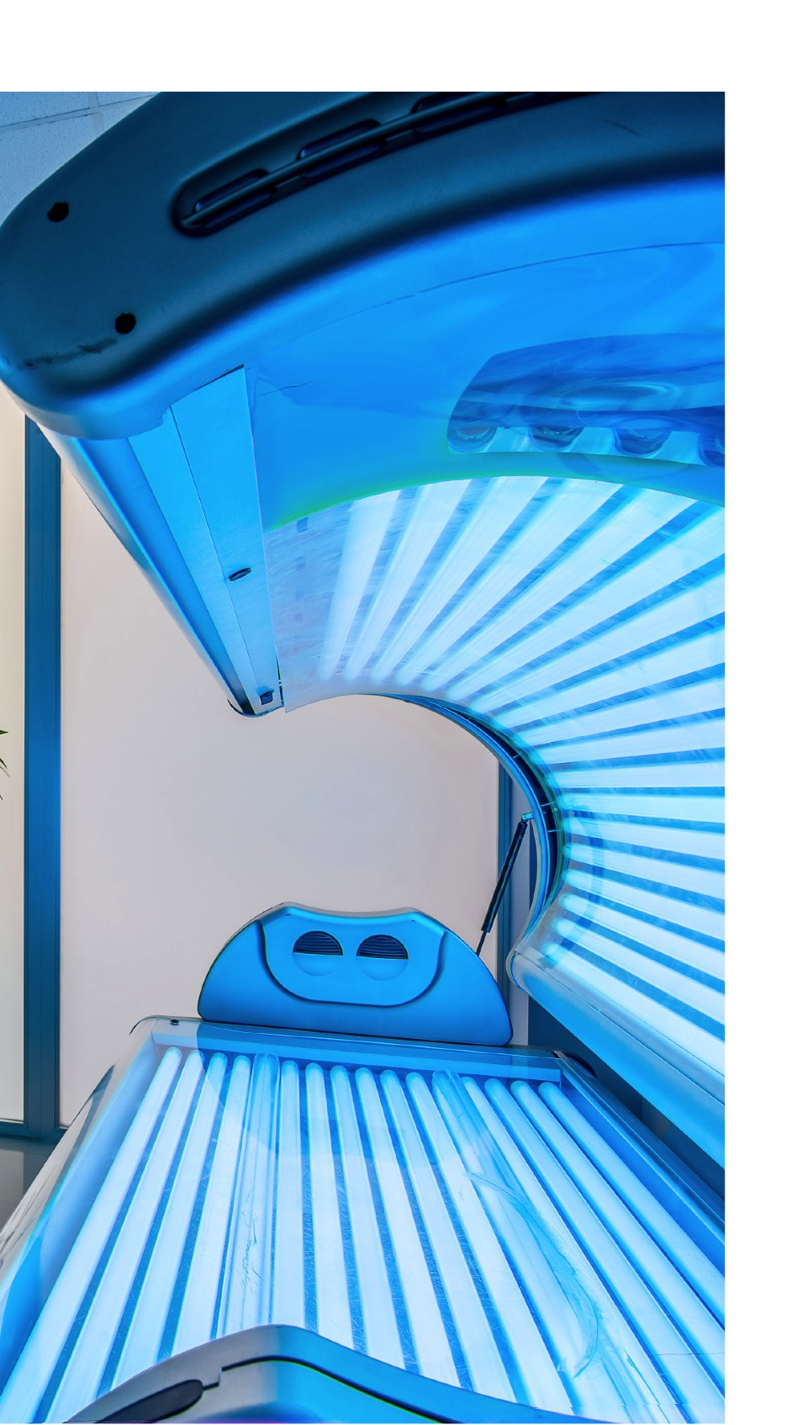
What about tanning beds?
• Sun beds are not a safe way to tan.
• They can be more dangerous than a suntan.
• Sun beds release UVR just like the sun— can be up to 3 times stronger than the midday summer sun.
• Adolescents and young people who use solaria/tanning beds have a 75% increased risk of developing melanoma.
• Commercial solariums are banned in ACT and all states in Australia.
Notes:
Here's what everyone should know about the risks of using a sun bed
The Cancer Council does not recommend solarium use for cosmetic tanning under any circumstances (a solarium is a room equipped with sunlamps or sun beds, which can be used to acquire an artificial suntan).
Overexposure to ultraviolet (UV) radiation is thought to be the primary risk factor for most skin cancers. As noted in the Cancer Council’s website (2018), solariums emit UVA and UVB radiation, both known to contribute to skin cancer. Indoor tanning beds deliver UV rays just as the sun does. In fact, high-pressure tanning bulbs can deliver as much as 15 times the UV radiation we receive from the sun.
Using a tanning bed before age 35 increases your risk of developing melanoma by 75%.
A 15-to-30-minute session in a tanning bed can equal an entire day at the beach.
Avoid Tanning Beds and Sunlamps
As of January 2016, commercial solariums were banned in all states in Australia. ACT has also banned commercial solariums. There are no commercial solariums operating in the Northern Territory.

Slide 14
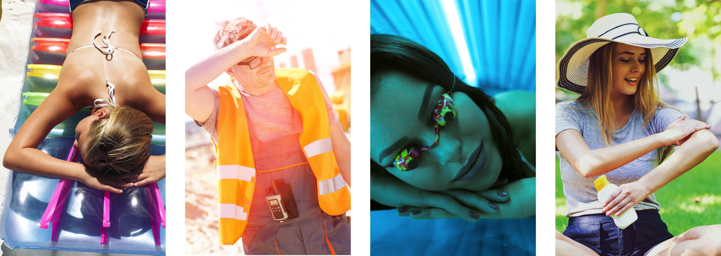
Where is the risk?
Identify the risky behaviours in the situations below.
Notes:
From left to right:
Vulnerable parts of body exposed: back, shoulders, neck, ears, face, scalp, arms, eyes. Even if there is SPF30 on some parts of the body, eyes and scalp are not protected.
No hat to protect face, scalp, ears and neck; no sunglasses to protect eyes; arms exposed.
Tanning on a sun bed is more dangerous than in the sun. The Cancer Council of Australia does not recommend solarium use for cosmetic tanning under any circumstances.
No sunglasses; arms, knees and legs exposed. Good that suncream is being applied but it should be applied 20 minutes before going out in the sun (although she could be reapplying, which is good).

Slide 15
Protecting yourself from skin cancer
• Limit sun exposure 10am–4pm (or whenever the UV level is above 3)
• Cover up your skin, especially arms and legs.
• Wear a wide-brimmed hat to protect eyes, ears, face and neck.
• Wear wrap-around sunglasses.
• Use SPF 30 or higher broad-spectrum sunscreen; re-apply every two hours or after swimming or excessive sweating.
• Stay in the shade whenever possible
Notes:
Limit direct sun exposure during the middle of the day
UV rays are most intense during the middle of the day, usually between the hours of 10 AM and 4 PM. If you are unsure about the sun's intensity, take the shadow test: If your shadow is shorter than you, the sun's rays are the strongest. Plan activities out of the sun during these times. If you must be outdoors, protect your skin.
UV rays reach the ground even on cloudy days. UV rays can also pass through water, so don't assume you're safe if you're in the water and feeling cool. Be especially careful on the beach and in the snow because sand and snow reflect sunlight, increasing the amount of UV radiation you receive.
Cover up : When in the sun, wear clothing to protect as much skin as possible. Long-sleeved shirts, long pants, or long skirts are the most protective. Dark coloured, tightly woven fabrics protect better than light-coloured, loosely woven clothing.
Wear a hat: A broad-brimmed hat or legionnaire’s hat is ideal because both protect the neck, ears, eyes, forehead, nose and scalp.
Use SPF) 30 or higher broad spectrum sunscreen: Experts recommend products with an SPF of at least 30. The SPF number represents the level of protection against UVB rays provided by the sunscreen -- a higher number means more protection. But sunscreen does not give total protection - also use clothing, hats, sunnies and shade.
Wear sunglasses that block UV rays: Research has shown that long hours in the sun without eye protection increases the chances of developing eye disease. UV-blocking sunglasses can help protect your eyes from sun damage. Use sun-glasses that block UVA and UB+VB (check label) and are close fitting and wrap-around.

Slide 16
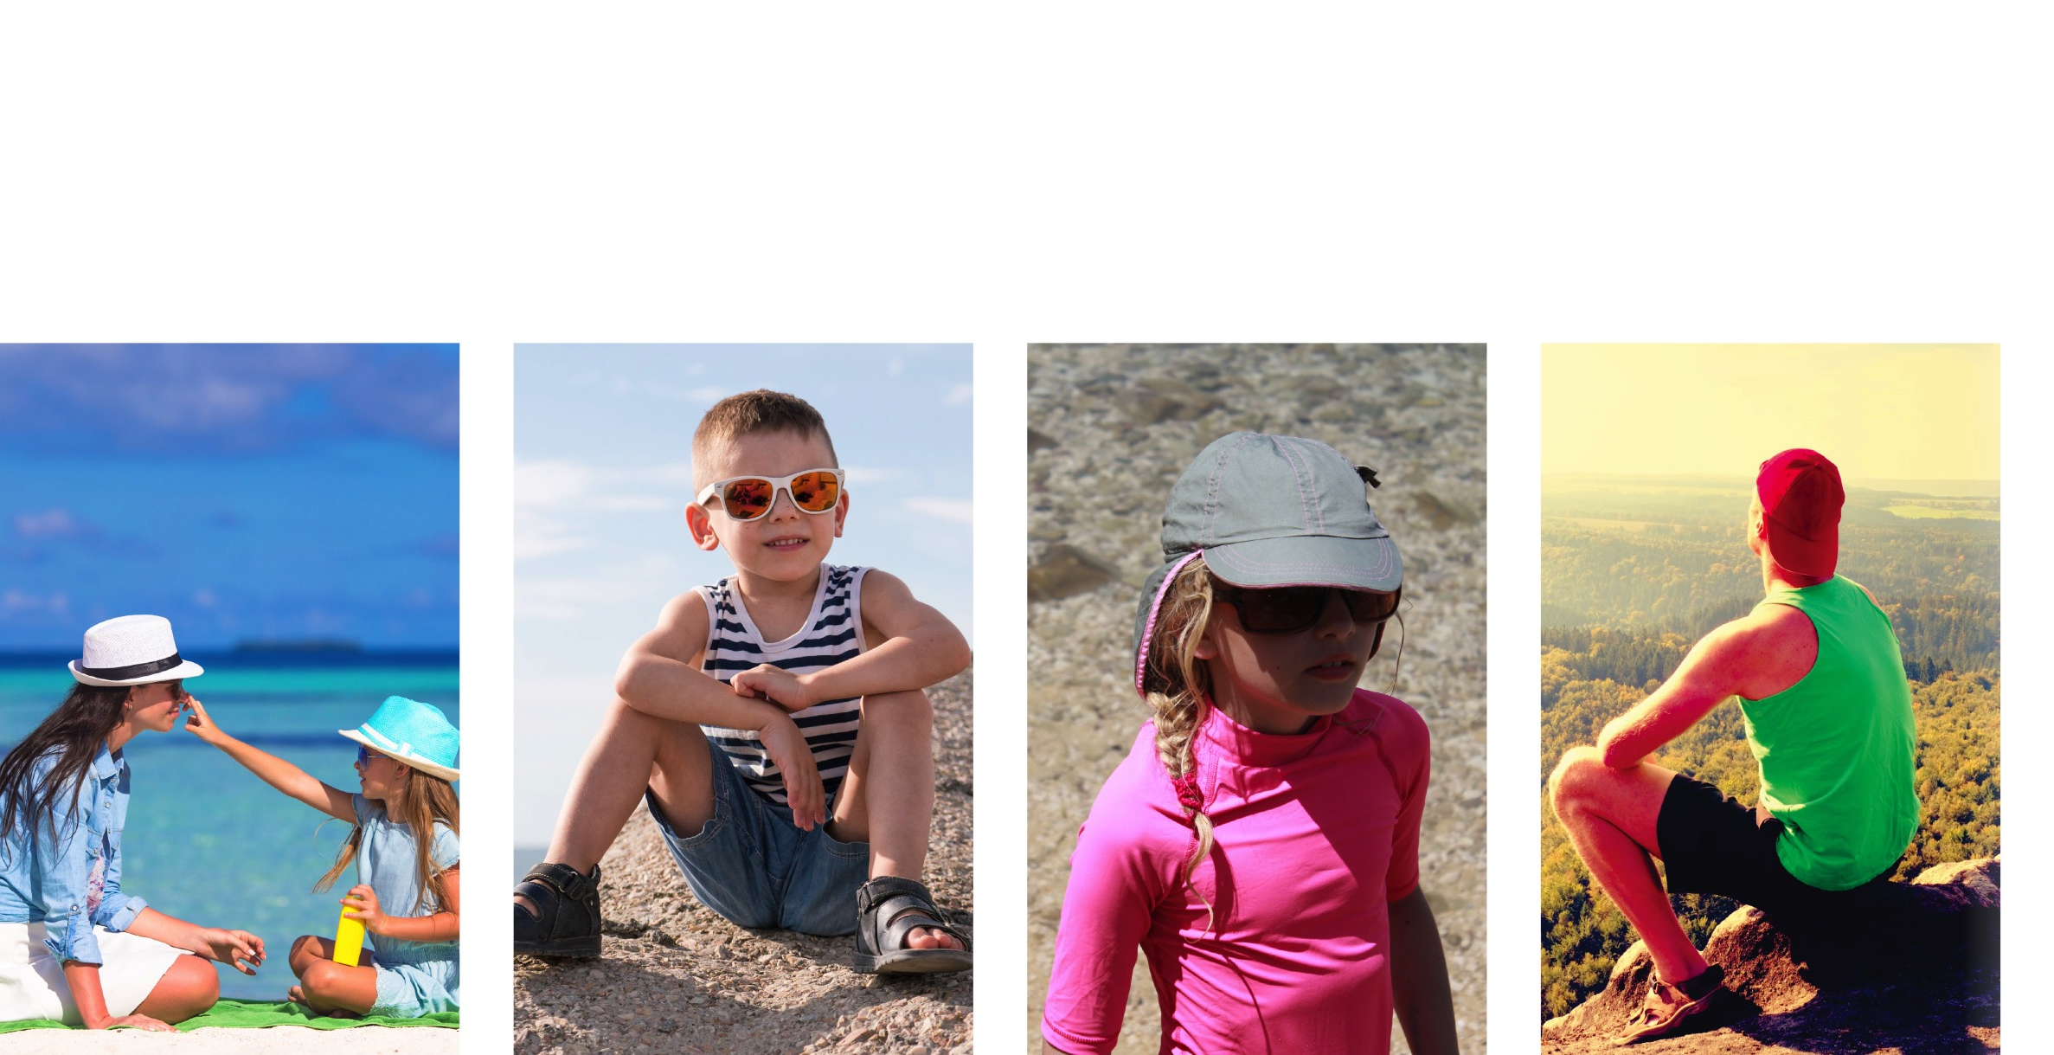
Where is the risk?
Identify the risky behaviours in the situations below.
Notes:
Some people think about sun protection only when they spend a day at the lake, beach, or pool. But sun exposure adds up day after day, and it happens every time you are in the sun.
In the images form left to right:
Both adult and child have exposed knees and legs; child has exposed arms. Hats would be better with dark colours under the brim to prevent reflection of the sun from the beach. Good that they are applying sun cream but it should be applied 20 minutes before going out in the sun (although they might be reapplying, which is good).
Child has no hat, inappropriate sunglasses, open shoes and vulnerable parts of his young body exposed to the sun.
Good upper body protection but a young child should have full-length sleeves and a better hat that covers ears and neck.
Inappropriate hat, open shoes, no sunglasses, exposure of vulnerable parts of the body e.g. knees, legs, shoulders, arms, face, ears.

Slide 17
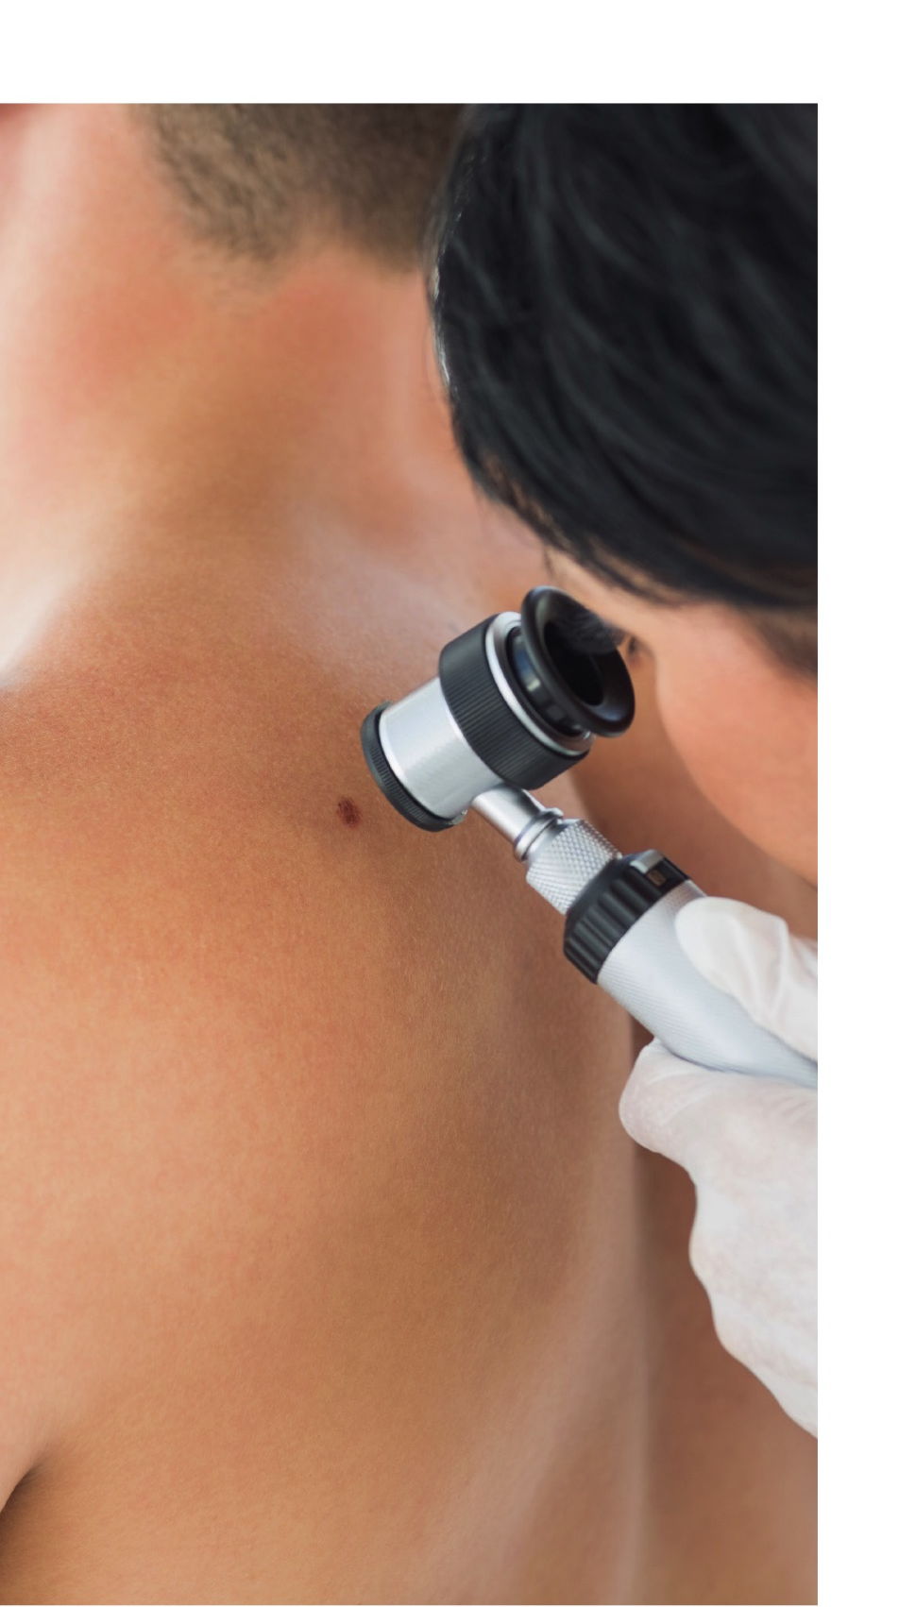
Early detection
• Check your skin regularly.
• If there is any change in the:
- size
- shape
- colour
of existing moles or spots, or new ones develop, have them checked by your doctor as soon as possible.
Notes:
Skin cancer can often be found early. Everyone can do things to find this cancer early, when it is curable. It is important to check your own skin about once a month and get a skin examination by a doctor or trained health professional as part of your routine cancer check-up.

Slide 18
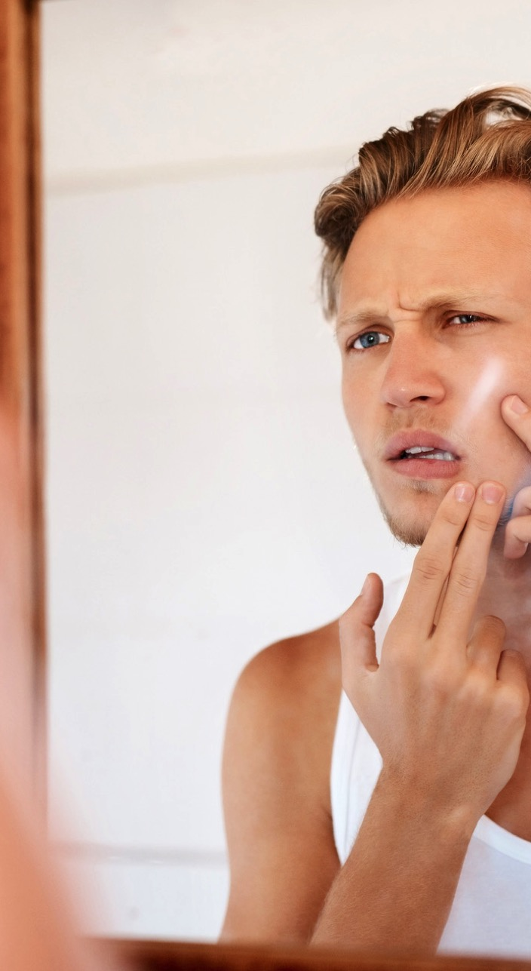
How to check your skin
Face the mirror and check:
• Face, scalp, ears, neck, chest, and belly. Females need to lift breasts to check the skin underneath.
• Under the arms, both sides of arms, the tops and bottoms of hands, between fingers, and fingernail beds.
Sit down and check:
• Front of your thighs, shins, tops of feet, in between toes, and toenail beds.
Notes:
How to Check Your Skin
It's important to check your own skin, preferably once a month. A self examination is best done in a well-lit room in front of a full-length mirror. A hand-held mirror can be used for areas that are hard to see.
The first time you inspect your skin, spend a fair amount of time carefully going over the entire surface of your skin. Learn the pattern of moles, blemishes, freckles, and other marks on your skin so that you'll notice any changes next time. Any trouble spots should be seen by a doctor. Follow these step-by-step instructions to perform your skin self-examination.

Slide 19
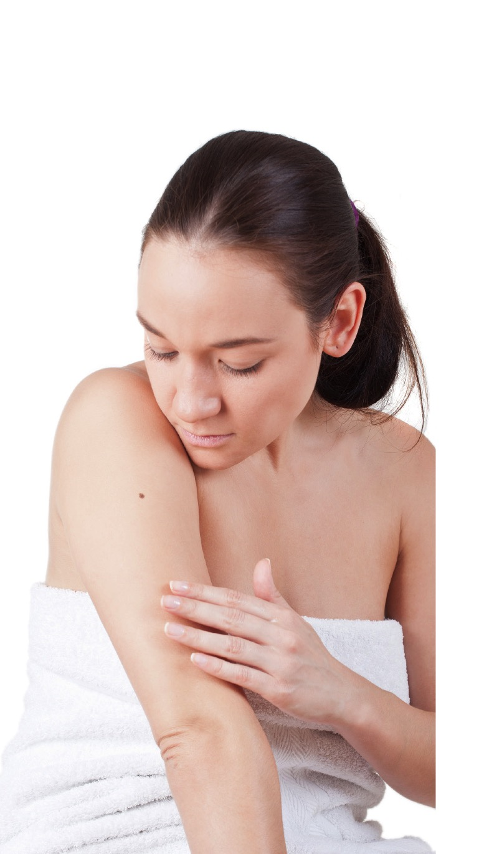
How to check your skin (cont.)
Use a hand mirror (with a large mirror where necessary) and check:
• Your back
• For both legs, bottoms of feet, calves, and backs of thighs.
• Buttocks, genital area, lower back, upper back,
and back of the neck.

Slide 20
Treatment options
• Surgery (including Mohs surgery and curettage)
• Cryotherapy
• Creams, lotions and gels (which might include immunotherapy or chemotherapy drugs)
Radiation therapy
Notes:
Source: Adapted from Cancer Council website (2019) and the Cancer Council Queensland website (2019)
Treatments:
Surgery is the most common and successful treatment for skin cancer. During surgery, the doctor uses a local anaesthetic to numb the affected area, then cuts out the skin cancer and some nearby normal-looking tissue (margin) before closing the wound with stitches. A pathologist checks the margin to make sure the cancer has been completely removed. If cancer cells are found in the margin, further surgery may be required. Sometimes the doctor will use skin from another part of the body (flap or graft) to cover the wound. These procedures may be performed in the doctor’s surgery but are sometimes done as day surgery in hospital under a local or general anaesthetic.
Mohs surgery, also known as microscopically controlled excision, is a specialised procedure that is only available at some private clinics and private hospitals. The surgeon removes layers of cells and checks them under a microscope immediately. The aim is to remove the cancer cells and leave only healthy tissue.
Curettage and cautery is when the doctor gently removes the cancer with a sharp tool called a curette. Then low-level heat (cautery) is used to stop the bleeding and destroy any remaining cancer cells. The wound should heal within a few weeks, leaving a small, flat, round, white scar. Usually used to treat BCCs and SCCs.
Cryotherapy is used to treat sunspots and some skin cancers. Liquid nitrogen is sprayed onto the skin to freeze and destroy the cancer cells. This creates a wound, which will be sore and red for a few days and may weep or blister. A crust will form on the wound and the dead tissue will fall off after 1–4 weeks. New, healthy skin cells will grow and a scar may develop.
Topical treatments—treating skin spots and some cancers with creams, lotions and gels prescribed by a doctor. They may contain immunotherapy or chemotherapy drugs as their active ingredient. Treatment can cause symptoms like skin reddening, scabbing, discomfort, tenderness, pain, rash etc.
Photodynamic therapy is the use of a light source and a cream to treat sunspots, superficial BCCs and squamous cell carcinoma.
Cancers that are hard to treat with surgery may require treatment with radiation therapy, which uses radiation such as x-rays or electron beams to damage or kill cancer cells. It is used for BCC or SCC in areas that are difficult to treat with surgery, such as the face, and for cancers that have spread or come back.

Slide 21
Three things to remember
1. Most skin cancers are preventable by limiting unprotected exposure to the sun.
2. Most skin cancers can be treated successfully if detected early—even melanoma.
3. When out in the sun Slip! Slop! Slap! And more!
• Slip on a shirt
• Slop on SPF 30 or higher broad spectrum sunscreen
• Slap on a hat
• Slide on some sunglasses
• Seek shade
Notes:
Nearly all skin cancers are preventable by limiting unprotected exposure to the sun.
Most skin cancers can be treated successfully if detected early – even melanoma.
When out in the sun, seek shade and “Slip! Slop! Slap! Slide! Seek!”
Slip on a shirt
Slop on SPF 30 or higher broad spectrum sunscreen
Slap on a hat
Slide on sunglasses
Seek shade

