Slide 1
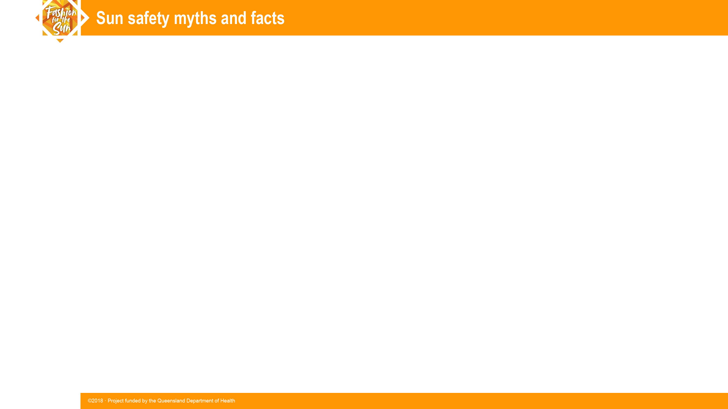
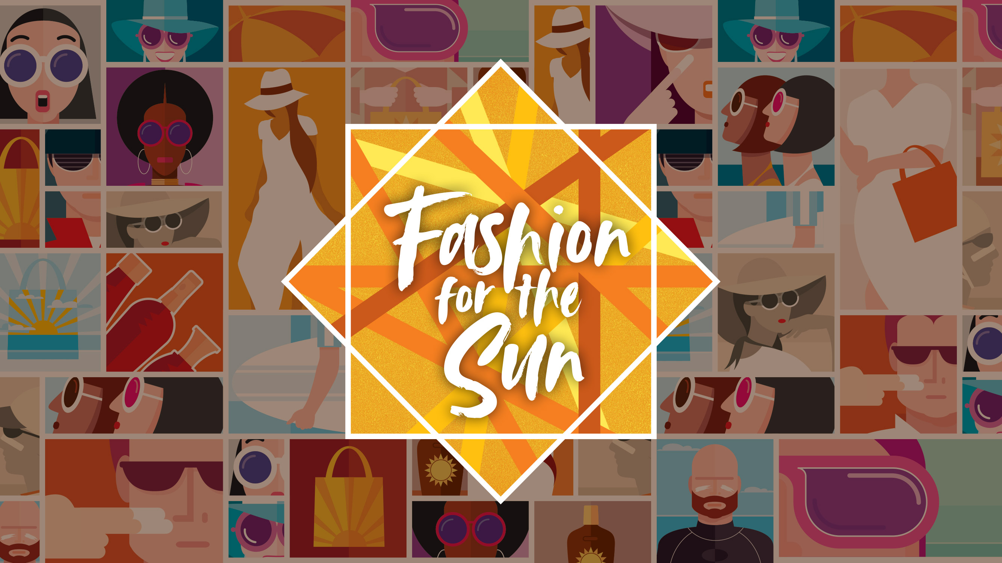

Slide 2
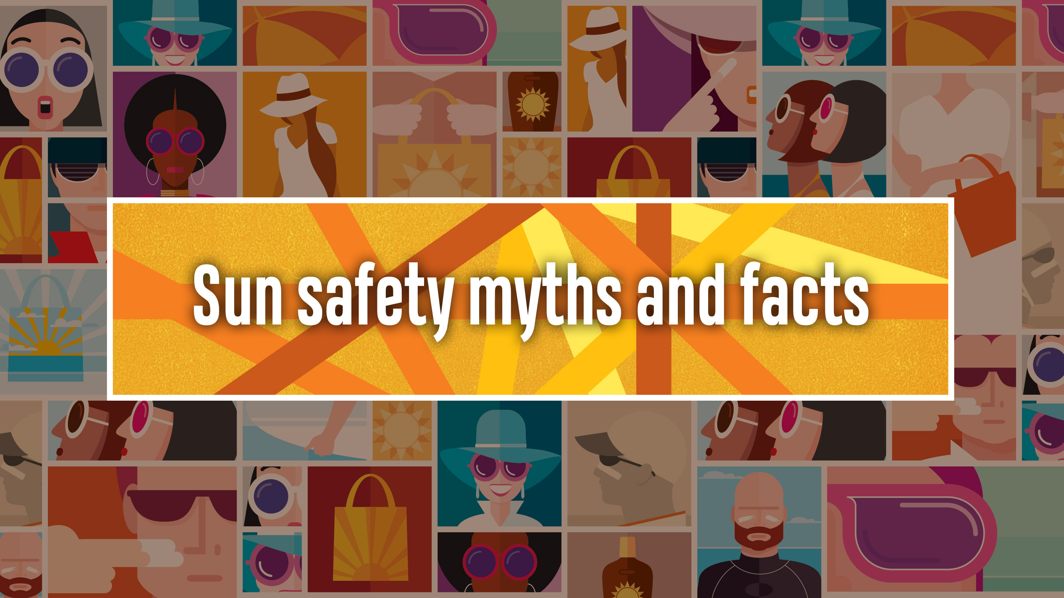
Notes:
This presentation has been adapted from Fact file C: Sun safety myths and facts so that some statements are true (in the fact file, all statements are myths). It addresses ten issues about which many people have misunderstandings, for example, who is most at risk, when sun protection is needed etc.
The PowerPoint presentation: Skin cancer and sun protection is a suitable complement to this presentation.
Like Fact file C. Sun safety myths and facts, this presentation could also be used in conjunction with Student response sheet 4: Delving deeper into sun safety: Think, pair, share, in which students develop a quiz for peers related to myths that are important to dispel. They could also develop, for example, posters, newsletter articles and/or slide shows to illustrate the myths and facts associated with sun safety. Some students could develop posters, while others could develop newsletter articles and others could develop slide shows. The newsletter articles could be collated into a ‘Special Edition’ newsletter to be distributed to relevant people. The collated set of resources developed by students could be used to provide a multi-modal presentation to their peers and/or parents and/or staff.
The notes that accompany these slides are there to assist the teacher. It is expected that the teacher will decide which of this additional information is suitable for the student cohort. The notes also provide additional information that might be useful for responding to student questions.

Slide 3
Fact (True) or Myth (False)
Sunscreen provides enough sun protection.
Skin cancer is a less serious form of cancer because it can easily be cut out.
Skin cancer affects people with all skin types.
Skin cancer happens to young people.
Skin cancer is caused by sunburn.
You only need sun protection between 10am and 2pm.
Tanning lotions and sprays protect the skin from UVR.
Using a sun bed is safer than tanning in the sun.
You need deliberate sun exposure for vitamin D.
You only need sun protection on hot, sunny days.
Notes:
Before showing the facts, ask students to individually identify if they think the statements are true (fact) or false (myth). They can then check off whether they got them right or not as you give the correct answer to each one in the slides that follow.

Slide 4
Sunscreen provides enough sun protection.
1
• Sunscreen does NOT provide enough sun protection.
• Even sunscreen with SPF30 or higher wears off and needs to be reapplied regularly:
  - particularly after swimming or excessive sweating
  at least every 2 hours.
• Also use shade and sun-savvy clothing, hats and sunnies.
Notes:
The SPF (Sun Protection Factor) of a sunscreen is a measure of how well it protects the skin from sunburn. Sunscreens need to be applied liberally to achieve the SPF protection claimed on the label.
The Cancer Council recommends using any sunscreen that is labelled broad spectrum, water-resistant and SPF30+ or above. It will filter UVR and protect from reflected UVR e.g. from water, sand and concrete.
It should be applied 20 minutes before going out in the sun. Use 1 teaspoon for the face, ears and neck, and 1 teaspoon for each limb as well as for both front and back of the torso.
The Cancer Council notes that SPF50+ offers only marginally better protection from Ultra Violet (UV) radiation than SPF30+, filtering out 98% of UV radiation compared to 96.7% blocked by SPF30+. SPF50+ sunscreen still needs to be applied just as liberally, re-applied every two hours (or after swimming, exercising and towel drying) and used in combination with other sun protection measures including sun protective hats, protective clothing, sunglasses and shade.
Sun-savvy clothing should cover the neck, shoulders, arms and knees.
Hats should be wide-brimmed with a dark colour under the brim to prevent reflection on to the face.,
Sunglasses should be large and wrap-around.

Slide 5
Skin cancer is a less serious form of cancer because it can easily be cut out.
2
• Skin cancer is very serious.
• Treatment is not always as easy as removing a mole.
• Melanoma is the most dangerous form of skin cancer. It can travel to other parts of the body, making it difficult to treat.
Notes:
What is skin cancer?
Skin cancer is a disease of the body’s skin cells. It is usually caused by the sun’s ultraviolet radiation damaging the skin cells. When the skin cells die or are damaged, more skin cells are produced to replace them. Sometimes, this regrowth becomes disordered and cells multiply and form a tumour (or growth). The tumour can continue to grow and destroy healthy cells.
The removal of skin cancer can result in disfiguring scars.
How it spreads:
Cancer cells can break off from the tumour and can be carried to other parts of the body by the bloodstream or lymphatic system. These cancer cells can then multiply and form other tumours in other parts of the body, including the brain, liver and lungs.

Slide 6
Skin cancer affects people with all skin types.
3
• Skin cancer affects people with all skin types.
• It is less common in people with darker skin,
but it is often found at more advanced stages.
Notes:
People most at risk
All skin types can be damaged by exposure to ultraviolet radiation. Excessive exposure in the first 20 years of life is very dangerous regardless of skin type.
While some people such as naturally dark (or olive) skinned people have skin types that are less likely to burn, they are still at risk of developing skin cancer. However, the risk is lower.
Nevertheless, dark-skinned people still get skin cancer, although their skin cancers may develop in unusual places, for example under their fingernails or on the soles of their feet.

Slide 7
Skin cancer happens to young people.
4
• Melanoma is the most common cancer in young Australians (15–39 year-olds).
• Skin cancer makes up 20% of all their cancer cases.
• Melanoma kills more young Australians
(20–39 year-olds) than any other single cancer.
Notes:
In 2016, the number of new cases of melanoma in people aged 0–39 years was estimated to be 1221. The highest incidence was estimated to be in 60– 69 year-olds (3247 new cases).
In 2016, deaths in Australia due to melanoma in 0–39 year-olds was estimated to be 50 (deaths due to melanoma across all age groups was 1617). For this age group, the number of deaths has been progressively decreasing since 1995. This is attributed to the many sun protection campaigns and sun protection policies e.g. in schools that have been in place for most of their lives.
However, as noted by the Cancer Council website in 2018, one in every five teenagers in Australia gets sunburn on an average summer weekend, with sunburn causing 95% melanomas.
Melanoma is the most common cancer in 15–39 year-olds, making up 20% of all their cancer cases.
For all age groups, skin cancer incidence (number of new cases) and deaths are greater in males than females (approximately 50% more males than females—in 2018 for males there were approximately 60 new cases on melanoma per 100,000 people; for females approximately 40 new cases per 100,000 people).

Slide 8
Skin cancer is caused by sunburn.
5
• Sunburn causes 95% of melanomas—the cell damage is severe when the skin is burnt.
• Sun exposure that does not result in burning can still damage skin cells and increase risk of skin cancer. Regular exposure to UVR year after year can cause skin cancer.
• Even short sun exposure adds up over time.
Notes:
According to the Australian Cancer Council website (2018), sunburn causes 95% of melanomas, the most deadly form of skin cancer. Sun exposure that doesn't result in burning can still damage skin cells and increase risk of developing skin cancer. Evidence suggests that regular exposure to UV radiation year after year can also lead to skin cancer.
The site notes that in Australia, 1 in 8 adults and 1 in 5 teenagers are sunburnt on an average summer weekend. Many people get sunburnt when they are taking part in water sports and activities at the beach or a pool, as well gardening or having a barbeque.
Sunburn is also common on cooler or overcast days, as many people mistakenly believe UV radiation is not as strong. This is untrue–you can still be sunburnt when the temperature is cool.
Each time the skin is exposed to ultraviolet radiation (UVR) from the sun, whether on sunny or overcast days, changes take place in the structure and function of the skin cells. Over time, the skin cells can become permanently damaged. This damage gets worse with each exposure to ultraviolet radiation and increases the risk of skin cancer when new skin cells are produced to replace the damaged ones.

Slide 9
You only need sun protection between 10am and 2pm.
6
• If the UVI is 3 or above, protect your skin regardless of the time of day.
• In some parts of Australia, UVR can reach harmful levels as early as 7am.
Damaged skin becomes wrinkled, harsh and, if skin cancers have to be cut out, disfigured.
Notes:
The free SunSmart app lets you know when you do and when you don't need sun protection, making it easier than ever to be SunSmart.
With a few clicks, you can find the weather, temperature, UV level and sun protection times for the day anywhere in Australia so you can be prepared for the day ahead.
Sun protection times in the app are based on the UV information issued daily by the Bureau of Meteorology.
You can set a default location to quickly access information for your home town.
The app also offers a reminder function that alerts the user of their daily sun protection needs, when it's safe to get some sun for vitamin D and a sunscreen calculator.

Slide 10
Tanning lotions and sprays protect the skin from UVR.
7
• Fake tanning lotions and spray tans do not protect your skin from UVR because they do not contain sun protection factor (SPF).
Notes:
According to the Cancer Council website (2018), a tan is not a sign of good health even though almost 50% Australian adults still believe that a tan looks healthy. Tanning is a sign that you have been exposed to enough UV radiation (from the sun or solarium) to damage your skin. This will eventually cause loss of elasticity (wrinkles), sagging, yellowish discolouration and even brown patches to appear on your skin. Worst of all, it increases your risk of skin cancer.
A tan will offer only limited protection from sunburn, usually equivalent to SPF3, depending on your skin type. It does not protect from DNA damage, which can lead to skin cancer.
In November 2011, Cancer Council Australia issued a media release stating that:
there had been a 15% fall in teens who prefer a tan since 2003–04 (from 60% to 45%)
only 12% of teens believed a tanned person is more healthy.
The then CEO of the Cancer Council said, “While these are encouraging results, we’ve still got a big job to convince the remaining 45% of teens to ditch a tan”.
For discussion with students:
That was back in 2011.
Ask the students what they think the percentage of students who currently prefer a tan would be.
Maybe do a show of hands as to whether they like to have a tan.
Discuss with students why some teens prefer a tan and don’t heed the sun safety messages.
Discuss the role of the fashion industry in promoting skin cancer by designing summer fashions that expose a lot of skin to the sun.

Slide 11
Using a sun bed is safer than tanning in the sun.
8
• Sun beds are not a safe way to tan
• They can be more dangerous than a suntan.
• UVR from sun beds can be up to 3 times stronger than the midday summer sun.
• Adolescents and young people who use sun beds have a 75% increased risk of developing melanoma.
Notes:
As noted in the Cancer Council’s website (2018), solariums emit UVA and UVB radiation, both known causes of cancer (a solarium is a room equipped with sunlamps or sun beds, which can be used to acquire an artificial suntan).
The Cancer Council does not recommend solarium use for cosmetic tanning under any circumstances.
As of January 2016, commercial solariums were banned in all states in Australia. ACT has also banned commercial solariums. There are no commercial solariums operating in the Northern Territory.

Slide 12
You need deliberate sun exposure for vitamin D.
9
• Most people get enough UV exposure to maintain vitamin D levels through their usual outdoor activities.
• It is unsafe to seek extra sun to top-up vitamin D levels.
Notes:
What is vitamin D?
Vitamin D is produced when our skin is exposed to ultraviolet B (UVB) light emitted by the sun. It can also be obtained from some foods. We need vitamin D for strong and healthy bones and muscles.
How much sun do we need for healthy bones?
For most Australians, sunshine is the main source of vitamin D. The amount of sun exposure required is relatively low. However, some Australians do not have adequate vitamin D levels, especially in winter. Required sun exposure times will vary based on season, location, area of skin exposed and skin type. It is important to balance the need for sun exposure to produce adequate vitamin D, at the same time avoiding the risk of skin damage from too much exposure.
Most people get enough UV exposure through their normal outdoor activities such as going to school, shopping etc. When the UV Index is 3 or above (such as in summer), just a few minutes outdoors on most days of the week is enough. In late autumn and winter in some southern parts of Australia, when the UV Index falls below 3, it is recommended to spend time outdoors in the middle of the day with some skin uncovered e.g. arms or legs.
Ask students who they think is at risk of vitamin D deficiency and why. Check that they cover:
Naturally dark skinned people, who need more UV exposure as the pigment in their skin reduces UV penetration.
People who cover their skin for religious or cultural reasons
Frail/elderly, chronically ill or institutionalised people who live mostly indoors
People who are obese
Babies and infants of vitamin D deficient mothers
People with poor absorption of calcium and vitamin D e.g. because of medications
People who avoid sun exposure because they have had or are at high risk of skin cancer
People in these groups should consult their doctor for advice on vitamin D supplementation. Over-exposure to UV is never recommended even if you have a vitamin D deficiency.
Website sources: Cancer Council; Osteoporosis Australia

Slide 13
You only need sun protection on hot, sunny days.
10
• Sunny, cloudy, or raining—UVR is always present during daylight.
• You are at risk of skin damage when the UVI is 3 or above (UVI is a measure of the sun’s UV strength).
• In some parts of Australia you need to use sun protection strategies every day.
See also next slide.
Notes:
UVR = Ultraviolet radiation
UVI = Ultraviolet index, a measure of the sun’s UV strength
It doesn’t matter if it’s sunny, cloudy or raining—UVR is always present during daylight.
The ultraviolet index (UVI) provides a consistent international measure of the sun’s ultraviolet strength. It measures UVR on a scale of 1 to 11 and beyond. The higher the number, the stronger the radiation and the faster the skin will burn.
In some parts of Australia the skin can be sunburnt in as little as 10 minutes during summer.
You are at risk of skin damage when the UV Index is 3 or above.

Slide 14
You only need sun protection on hot, sunny days (cont).
10
• In those parts of Australia north of 30ºS you may need to use sun protection strategies every day:
- all of Queensland and the Northern Territory
- Western Australia north of Kalgoorlie
- New South Wales north of Coffs Harbour
- South Australia north of Lake Torrens
Notes:
There are many factors that influence when sun protection is necessary. One of them is the distance from the equator. The slide gives broad indications of when sun protection may be necessary all year round.
You may need sun protection from August through to May for areas 30ºS to 40ºS—Western Australia south of Kalgoorlie, New South Wales south of Coffs Harbour, South Australia south of Lake Torrens, all of Australian Capital Territory and Victoria.
You may need sun protection September through to April for areas 40ºS to 50ºS (all of Tasmania).

Slide 15
Fact (True) or Myth (False) responses
Sunscreen provides enough sun protection. (False)
Skin cancer is a less serious form of cancer because it can easily be cut out. (False)
Skin cancer affects people with all skin types. (True)
Skin cancer happens to young people. (True)
Skin cancer is caused by sunburn. (Not always)
You only need sun protection between 10am and 2pm. (False)
Tanning lotions and sprays protect your skin from UVR. (False)
Using a sun bed is safer than tanning in the sun. (False)
You need deliberate
sun exposure for vitamin D. (False)
You only need sun protection on hot, sunny days. (False)
Notes:
At the end of the presentation, the teacher could:
brainstorm what students are still unsure about or want to know more
collate the responses on the board
respond to what students are unsure about or want to know more.

